Slide 2

Press play to learn more!

Slide 3

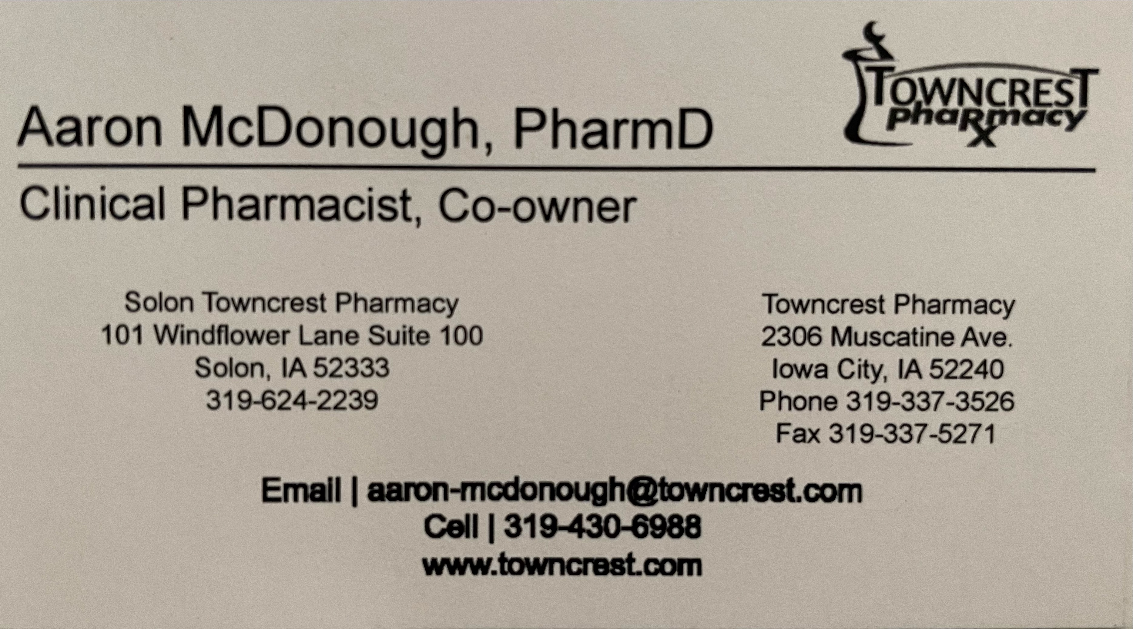
Contact Aaron To Get 3 Months Free!

